Slide 1



BHAVAN’S VIVEKANANDA COLLEGE OF SCIENCE, HUMANITIES
AND COMMERCE, SAINIKPURI, SECUNDERABAD
DEPARTMENT OF MICROBIOLOGY
AI DRIVEN DETECTION OF PLANT DISEASES AND NUTRIENT DEFICIENCIES USING MACHINE LEARNING
G. SATYA TARUN SRIYAMSU, PANJA GOWTHAMI, SAYALI JADHAV,
D. BHAVANI

Slide 2
ABSTRACT
Since plants are a primary source of human food, plant diseases pose a serious threat to food security by reducing crop yield, slowing plant growth, and causing significant economic losses. These diseases are commonly caused by fungi, bacteria, viruses, and adverse environmental conditions. Using leaves as a medium, we may detect a variety of visual signs as indicators of disease. The project's goal is to develop an AI-based picture categorization system that will transform agricultural disease management and detection. To conduct this project publicly accessible plant disease and deficiency image datasets were extracted to undergo preprocessing. ML training workflows such as TensorFlow or PyTorch were used to train CNNs or ViTs to classify plant health conditions based on visual features. The data that was utilized for the test consisted of a set of real-life images obtained from various locations. The model is trained to identify common plant diseases and deficiencies. The obtained results showed confidence rates to prove the efficiency of the model being used. Here we can find that Xception showed the highest success rate with 95.83% accuracy, ResNet - 50 + SVM with the accuracy rate of 91.2%, VGG- 16 with accuracy of 84%, Inception - ResNet - V2 with an accuracy rate of 83%, BPCNN - 9 with a rate of 82%, DCNN accuracy rate of 78% respectively.
Keywords: AI-based plant disease detection, Leaf image classification, Convolutional Neural Networks (CNNs), Vision Transformers (ViTs), Transfer learning (Xception), Accuracy evaluation

Slide 3
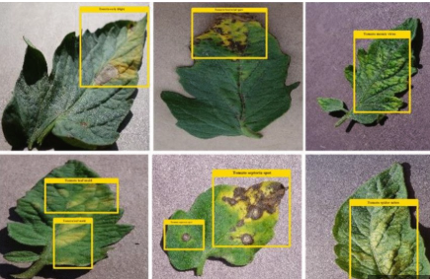
Introduction
  Food is vital to our livelihoods. On average, over the last few decades, approximately 40% of the world’s population has been employed in fields related to agriculture. (Serin, J., Jerith, G., Ebenezer, V., Jeyaraj, K., Jenefa, A., & Vargheese, M. et al., 2025)
  India’s agricultural sector faces persistent challenges due to the prevalence of plant diseases, which severely impact crop quality and productivity, exacerbating the ongoing food supply crisis. (Piska, G., Janaskar, S., Chandgadkar, O., Bhawsar, P., & Vishwakarma, P. P. et al., 2025)
  Plant diseases, resulting from bacterial, fungal and several other sources, adversely influence agricultural productivity and damage the plant morphology. (Ansari, A., Singh, S., & Akhtar, D. N. et al., 2025)

Slide 4

Aim
  The present project aims to recreate and extend a previously developed AI prototype by building a modern ML-based classification system that analyzes plant images to identify diseases and nutrient deficiencies, providing confidence scores along with simple scientific explanations.
Review of Literature
AUTHORS | RESEARCH GAP
(Ansari, A., Singh, S., & Akhtar, D. N. et al., 2025) | Absence of detailed and precise classification of the results
(Nazir, A. et al.,2022) | Most reviewed approaches rely heavily on PlantVillage-style datasets and lack real-field validation, nutrient deficiency focus, and explainable scientific outputs for practical use.”
(Serin, J., Jerith, G. G., Ebenezer, V., Jeyaraj, K. A., Jenefa, A., & Vargheese, M. et al.,2026). | Current systems do not use true multimodal fusion of leaf images and real-time soil sensor data for improved nutrient deficiency prediction.

Slide 5

Objectives
  Use ML and AI frameworks to train a model for classifying plant diseases and nutrient deficiencies.
  Build a dataset of plant images representing various conditions.
  Train, validate, and test ML models such as Convolutional Neural Networks or Vision Transformers.
  Provide clear, biologically accurate explanations of predicted conditions.
  Evaluate the accuracy, reliability, and farmer usefulness of the system.

Slide 6
Materials & Methodology
Deep Convolutional Neural Network (DCNN)
BPCNN-9 (Backpropagation-Based CNN)
VGG-16
Input (224 × 224 × 3)
↓
Conv3-64 → Conv3-64
↓
MaxPool (2×2)
↓
Conv3-128 → Conv3-128
↓
MaxPool (2×2)
↓
Conv3-256 → Conv3-256 → Conv3-256
↓
MaxPool (2×2)
↓
Conv3-512 → Conv3-512 → Conv3-512
↓
MaxPool (2×2)
↓
Conv3-512 → Conv3-512 → Conv3-512
↓
MaxPool (2×2)
↓
Flatten
↓
FC-4096 → FC-4096
↓
Output (Softmax, 1000 classes)
Input Image
↓
[Conv → ReLU] × N
↓
Pooling
↓
[Conv → ReLU] × N
↓
Pooling
↓
Flatten
↓
Fully Connected (Dense) Layer(s)
↓
Output Layer (Softmax / Sigmoid)
Input (224×224×3)
↓
Conv1 (32, 3×3) + ReLU
↓
MaxPool (2×2)
↓
Conv2 (64, 3×3) + ReLU
↓
MaxPool (2×2)
↓
Conv3 (128, 3×3) + ReLU
↓
Flatten
↓
Dense (128/256) + ReLU + Dropout
↓
Dense (64) + ReLU
↓
Output (Softmax / Sigmoid)

Slide 7
Materials & Methodology
Inception-ResNet-V2
Xception
ResNet-50 with Support Vector Machine (SVM)
Input (299 × 299 × 3)
↓
Stem Block
↓
Inception-ResNet-A × 5
↓
Reduction-A
↓
Inception-ResNet-B × 10
↓
Reduction-B
↓
Inception-ResNet-C × 5
↓
Global Average Pooling
↓
Dropout
↓
Fully Connected Layer
↓
Output (Softmax)
INPUT (299×299×3)
│
▼
ENTRY FLOW
Conv 3×3 (32, s2)
Conv 3×3 (64)
3 × [SepConv → SepConv → MaxPool (s2) + Residual]
│
▼
MIDDLE FLOW
8 × [SepConv → SepConv → SepConv + Residual]
│
▼
EXIT FLOW
[SepConv → SepConv → MaxPool (s2) + Residual]
SepConv (1536)
SepConv (2048)
│
▼
Global Avg Pool
│
▼
Fully Connected
│
▼
Softmax
Input Image (224x224x3)
↓
ResNet-50 Convolution Layers
↓
Residual Blocks (50 layers total)
↓
Global Average Pooling
↓
2048-D Feature Vector
↓
SVM Classifier
↓
Final Prediction

Slide 8
Materials & Methodology
  DATASET COLLECTION AND PREPARATION
  The dataset was collected from Kaggle.com and consists of real-life RGB leaf images.
  Total dataset size: 8,751 images, classified into 38 classes across multiple crops (tomato, apple, grape, corn, potato, orange, strawberry, squash, etc.).
  Images represent 4 major biological stress categories:
  Viral, Bacterial, Fungal, and Pest-induced damage
  The dataset demonstrates host–pathogen specificity, improving biological realism:
  Citrus greening → Orange
  Septoria leaf spot → Tomato
  The dataset contains visible variations in colour and texture, allowing the model to learn physiological symptoms like:
chlorosis, necrosis, fungal growth, lesions, and mite damage.

Slide 9
  Data Preprocessing & Dataset Splitting
  Images were organized class-wise using labels (plant + disease).
  Dataset was split into:
  Training: 70%
  Validation: 20%
  Testing: 10%
  Preprocessing steps:
  Resizing all images to 224 × 224 pixels
  Pixel normalization to range [0,1]
  Data augmentation was applied only on training data to improve generalization:
  Random rotation
  Horizontal flipping
  Width/height shifting
  Zoom transformation

Slide 10
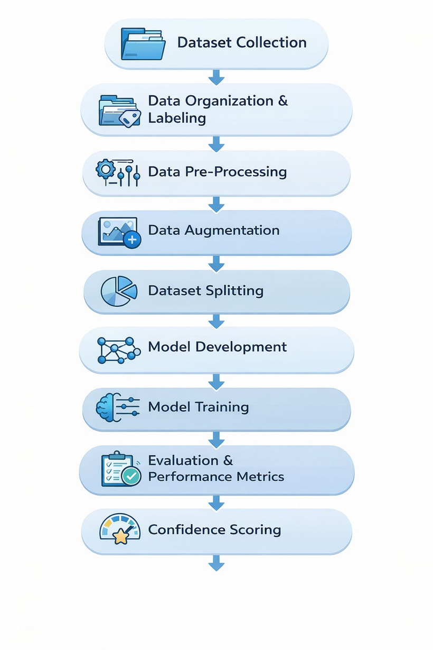
  Model Training, Evaluation & Output
  Multiple models were trained and compared: DCNN, BPCNN-9, VGG-16, Inception-ResNet-V2, Xception, ResNet-50 + SVM
  Training used categorical cross-entropy, Adam optimizer, batch size 32
  Performance was evaluated using accuracy, precision, recall, F1-score, and confusion matrix
  Final system outputs the predicted class + confidence score + simple biological explanation

Slide 11
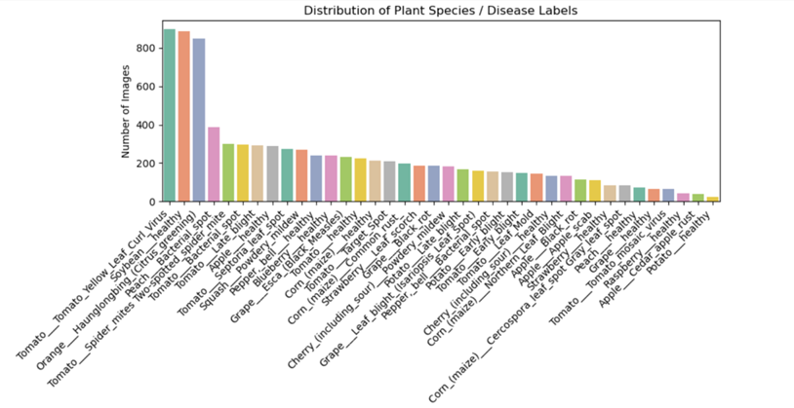
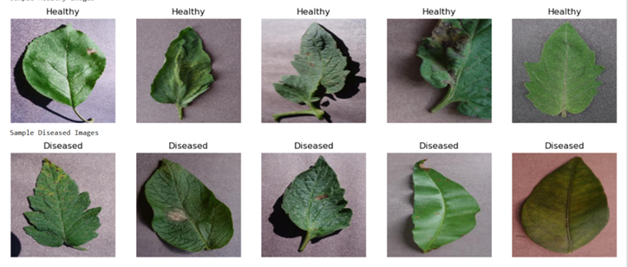
Data Analysis
It explored
  Class distribution (Diasease Vs Healthy leaves)
  Plant disease relationship (Plants prone to certain diseases)
  Environmental analysis
  Incorresct labeled detection
  Quality and diversity check of dataset
  Variations in leaf type colour
Four major categories
  Viral infections
  Bacterial infections
  Fungal infections
  Pest induced damage

Slide 12
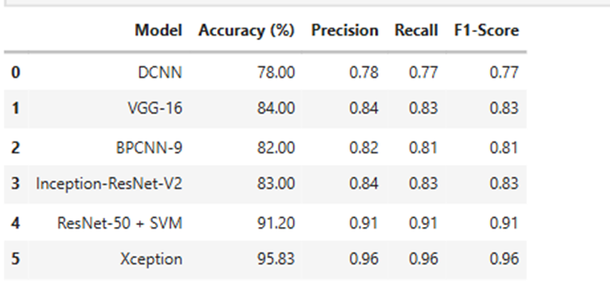
Results & Findings
  Xception achieved the highest accuracy (95.83%), with consistently high precision and recall, showing strong and reliable classification across all plant disease classes.
  ResNet-50 + SVM produced the second-best accuracy (91.20%), proving that using deep feature extraction + SVM improves classification compared to normal SoftMax output.
  Among transfer learning models, VGG-16 (84.00%) and Inception-ResNet-V2 (83.00%) showed similar performance, confirming that pretrained CNNs work well even with limited training.
  The custom-designed CNNs, BPCNN-9 (82.00%) and DCNN (78.00%) achieved moderate accuracy, showing that training from scratch is possible but less effective than transfer learning.
The comparative performance of deep learning and hybrid models for multi-class plant disease classification.

Slide 13
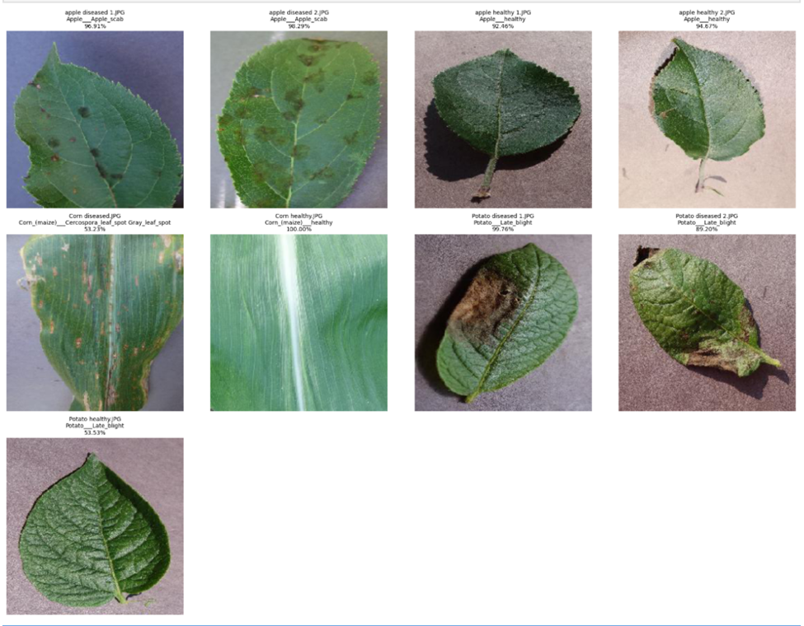
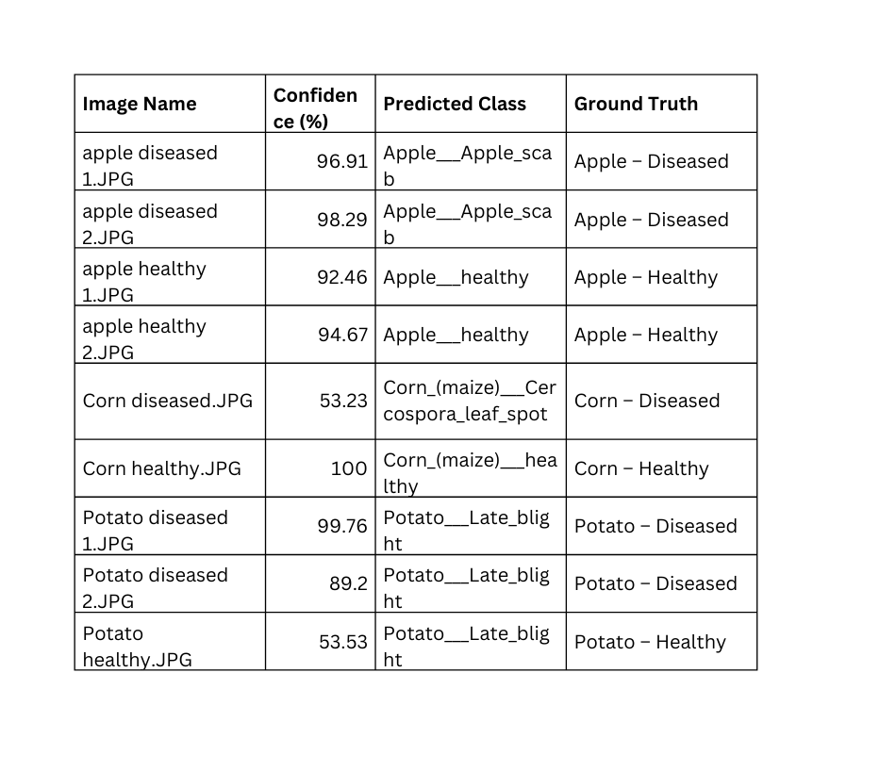
Results & Findings

Slide 14
Discussion
  The experimental results demonstrate that deep learning–based approaches are highly effective for multi-class plant disease classification.
  The Xception model achieved the highest accuracy of 95.83%, outperforming all other architectures. This superior performance can be attributed to the use of depth wise separable convolutions.
  The ResNet-50 + SVM hybrid model achieved the second-best performance with 91.20% accuracy, demonstrating the effectiveness of combining deep feature extraction with a classical machine learning classifier.
  Among the transfer learning models using softmax classifiers, VGG-16 achieved slightly better performance (84.00% accuracy) than Inception-ResNet-V2 (83.00% accuracy).
  The custom-designed CNN models, BPCNN-9 and DCNN, achieved accuracies of 82.00% and 78.00%, respectively. These results indicate that training CNNs from scratch is feasible but less effective compared to transfer learning, particularly when dataset size and diversity are limited.
  Overall, the findings emphasize the importance of transfer learning, efficient convolutional architectures, and hybrid classification strategies for automated plant disease detection.

Slide 15
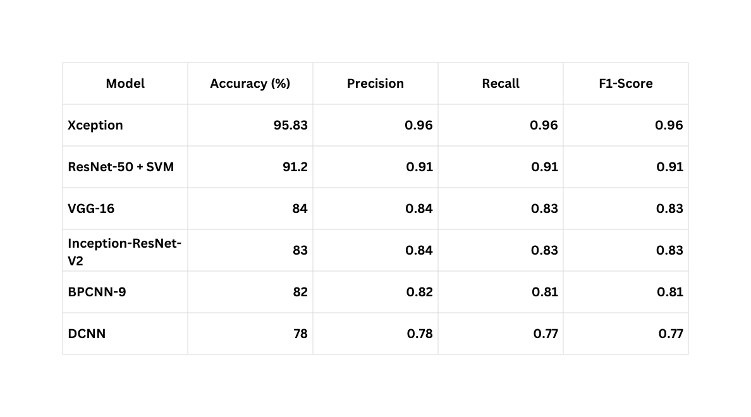
Conclusion
  The present study compared custom CNNs, transfer learning models, and hybrid models for multi-class plant disease classification using leaf images.
  Transfer learning performed better than training from scratch, proving pretrained features are important for agricultural image datasets.
  Xception achieved the best accuracy (95.83%), and ResNet-50 + SVM also performed strongly, showing hybrid deep learning + ML improves robustness.
  The framework shows strong potential for automated plant disease diagnosis, and future work can focus on lightweight real-time models, handling class imbalance, and field deployment.

Slide 16
Future Scope
  The project focuses on common conditions and is not meant to replace expert diagnosis. Thus,in future we may improve detection and classification capacity of the models.
  Further we can work to overcome challenges in detecting overlaping symptoms of certain diseases and deficiencies.
  The model accuracy can be nurtured by use of high quality dataset and diversity as real world images may vary in lighting, background, or clarity effecting predictions.

Slide 17
References
  Piska, G., Janaskar, S., Chandgadkar, O., Bhawsar, P., & Vishwakarma, P. P. (2025). Enhancing plant disease detection using machine learning approaches for improved agricultural productivity. International Journal of Electrical & Computer Engineering (2088-8708), 15(2).
  Ansari, A., Singh, S., & Akhtar, D. N. (2025). Ai-driven crop disease detection and management in smart agriculture. International Journal of Scientific Research in Science and Technology (IJSRST), SSN, 2395-6011.
  Nazir, A. (2022). AI-Driven Approaches to Enhance Plant Disease Detection and Monitoring: A Focus on Machine Learning in Agriculture. International Journal of Applied Sciences and Society Archives (IJASSA), 1(1), 9-15.
  Serin, J., Jerith, G. G., Ebenezer, V., Jeyaraj, K. A., Jenefa, A., & Vargheese, M. (2026). AI-Driven Smart Farming for Automated Plant Health Monitoring and Nutrient Deficiency Detection. ASEAN Journal of Scientific and Technological Reports, 29(1), e258175-e258175.
  Ansari, A., Singh, S., & Akhtar, D. N. (2025). Ai-driven crop disease detection and management in smart agriculture. International Journal of Scientific Research in Science and Technology (IJSRST), SSN, 2395-6011.
  Ghosh, D., Siddique, M. A., & Pal, D. (2024). AI-driven precision agriculture approach. AI in agriculture for sustainable and economic management, 6, 67.
  Barathkumar, S., Sellamuthu, K. M., Sathyabama, K., Malathi, P., Kumaraperumal, R., & Devagi, P. (2025). Advancements in soil quality assessment: A comprehensive review of machine learning and AI-driven approaches for nutrient deficiency analysis. Communications in Soil Science and Plant Analysis, 56(2), 251-276.

Slide 18

Acknowledgement
MANAGEMENT, DEPARTMENT OF MICROBIOLOGY & DEPARTMENT OF MATHEMATICS AND STATISTICS
BHAVAN’S VIVEKANANDA COLLEGE OF SCIENCE, HUMANITIES & COMMERCE,
SAINIKPURI, SECUNDRABAD, 500094.

